Slide 1


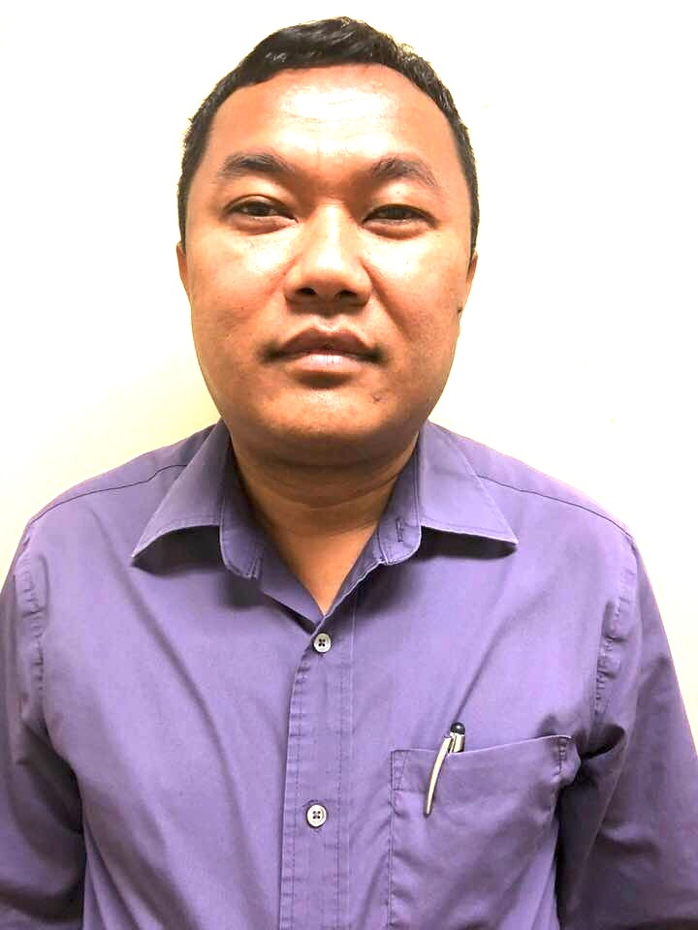
LOVE THE LOST
MINISTER ID# 47-33332430001
LAST NAME
TAMANG
FIRST NAME
PURNA
DOB:11-01-1979
GENDER:MALE
176 Imperial Dr.
Amherst, NY 14226
MINISTRY TITLE
PASTOR
Issued:09-08-2018
Expires:09-08-2024
Notes:
OK

Slide 2

LOVE THE LOST
MINISTER ID# 47-33332430002
LAST NAME
BHUJEL
FIRST NAME
RAM
DOB:01-21-1991
GENDER:MALE
176 Imperial Dr. Amherst, NY 14226
MINISTRY TITLE
PASTOR
Issued:09-08-2018
Expires:09-08-2024
Notes:
OK

Slide 3
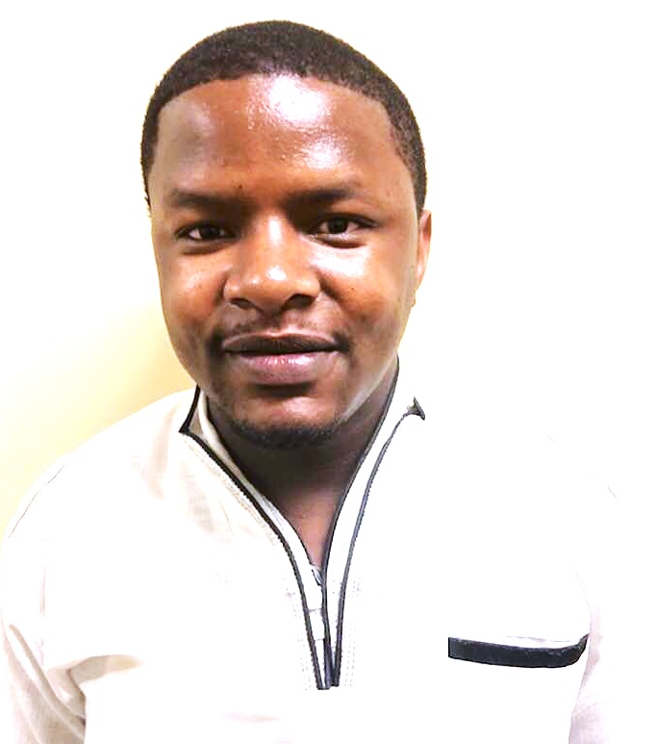
LOVE THE LOST
MINISTER ID# 47-33332430003
LAST NAME
AMANI
FIRST NAME
EMMANUEL
DOB:06-28-1993
GENDER:MALE
176 Imperial Dr. Amherst, NY 14226
MINISTRY TITLE
PASTOR
Issued:09-08-2018
Expires:09-08-2024
Notes:
OK

Slide 4
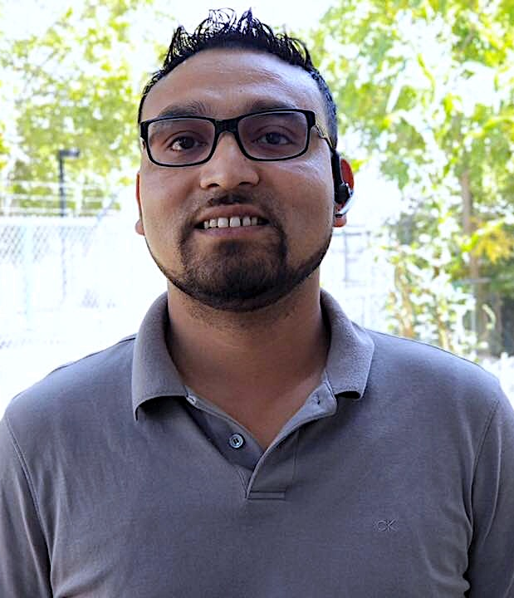
LOVE THE LOST
MINISTER ID# 47-33332430004
LAST NAME
DARJEE
FIRST NAME
UMESH
DOB:08-02-1983
GENDER:MALE
176 Imperial Dr. Amherst, NY 14226
MINISTRY TITLE
PASTOR
Issued:09-08-2018
Expires:09-08-2024
Notes:
OK

Slide 5
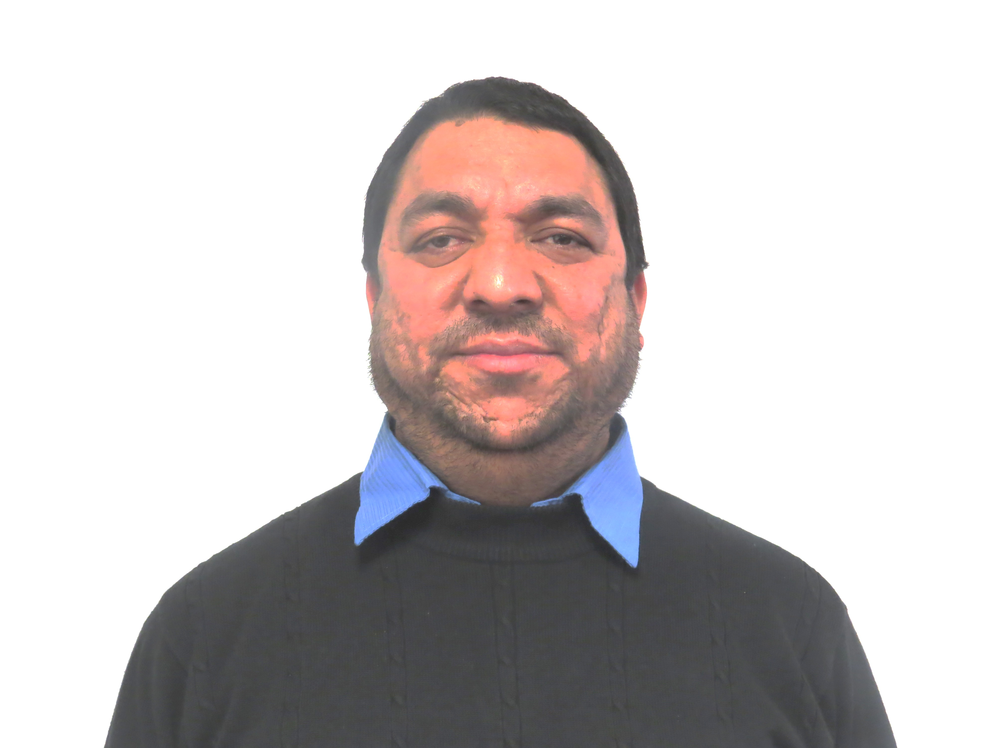
LOVE THE LOST
MINISTER ID# 47-33332430005
LAST NAME
KALIKOTEY
FIRST NAME
BIRENDRA
DOB:01-01-1980
GENDER:MALE
176 Imperial Dr. Amherst, NY 14226
MINISTRY TITLE
PASTOR
Issued:09-08-2018
Expires:09-08-2024
Notes:
OK

Slide 6

LOVE THE LOST
MINISTER ID# 47-33332430006
LAST NAME
KHADKA
FIRST NAME
BIJAYA
DOB:11-18-1994
GENDER:MALE
176 Imperial Dr. Amherst, NY 14226
MINISTRY TITLE
PASTOR
Issued:09-08-2018
Expires:09-08-2024
Notes:
OK

Slide 7

LOVE THE LOST
MINISTER ID# 47-33332430007
LAST NAME
GAJMERE
FIRST NAME
SANTA B.
DOB:03-10-1979
GENDER:MALE
176 Imperial Dr. Amherst, NY 14226
MINISTRY TITLE
PASTOR
Issued:09-08-2018
Expires:09-08-2024
Notes:
OK

Slide 8
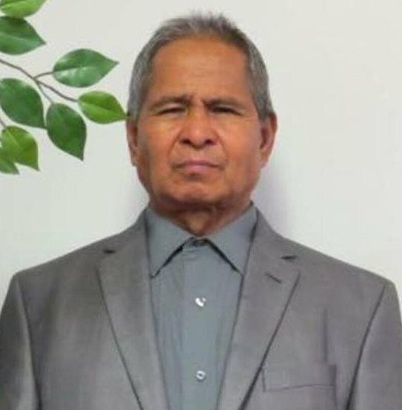
LOVE THE LOST
MINISTER ID# 47-33332430008
LAST NAME
BHUJEL
FIRST NAME
DHAN
DOB:04-25-1949
GENDER:MALE
176 Imperial Dr. Amherst, NY 14226
MINISTRY TITLE
PASTOR
Issued:09-08-2018
Expires:09-08-2024
Notes:
OK

Slide 9
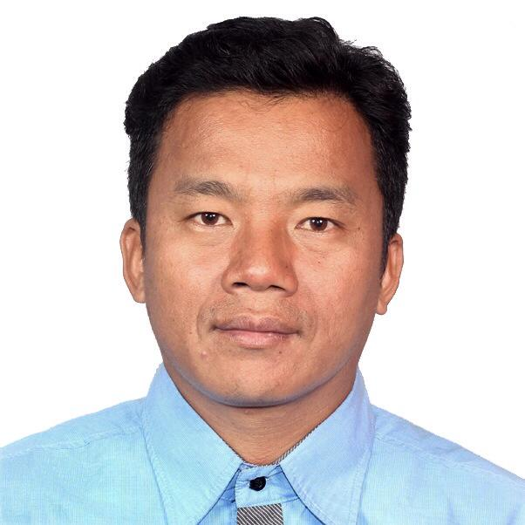
LOVE THE LOST
MINISTER ID# 47-33332430009
LAST NAME
RAI
FIRST NAME
KRISHNA
DOB:08-22-1975
GENDER:MALE
176 Imperial Dr. Amherst, NY 14226
MINISTRY TITLE
PASTOR
Issued:09-08-2018
Expires:09-08-2024
Notes:
OK

Slide 10
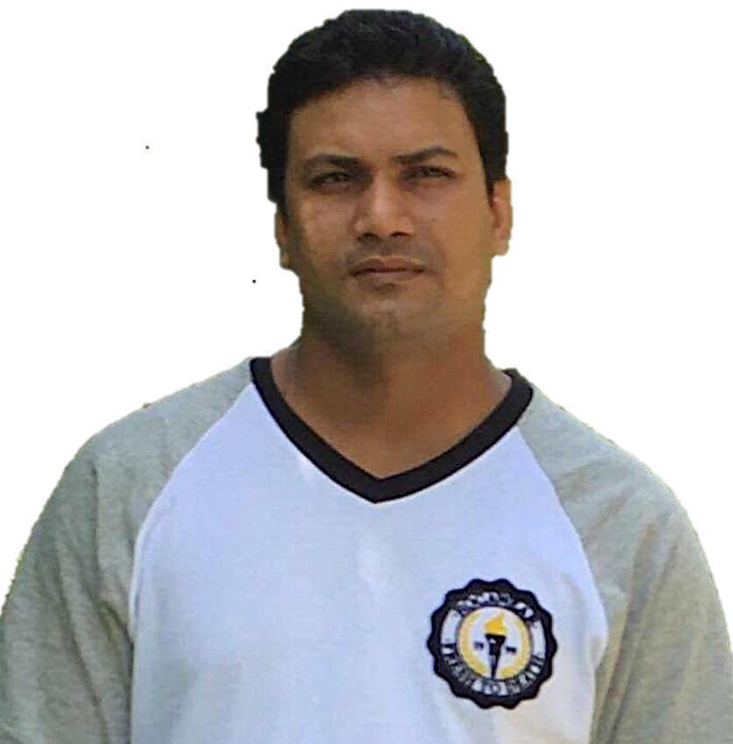
LOVE THE LOST
MINISTER ID# 47-33332430010
LAST NAME
POUDYEL
FIRST NAME
DAVE
DOB:01-01-1981
GENDER:MALE
176 Imperial Dr. Amherst, NY 14226
MINISTRY TITLE
PASTOR
Issued:09-08-2018
Expires:09-08-2024
Notes:
OK

Slide 11

LOVE THE LOST
MINISTER ID# 47-33332430011
LAST NAME
GUDIWADA
FIRST NAME
NIKHIL
DOB:02-20-1991
GENDER:MALE
176 Imperial Dr. Amherst, NY 14226
MINISTRY TITLE
PASTOR
Issued:09-08-2018
Expires:09-08-2024
Notes:
OK

