Slide 1
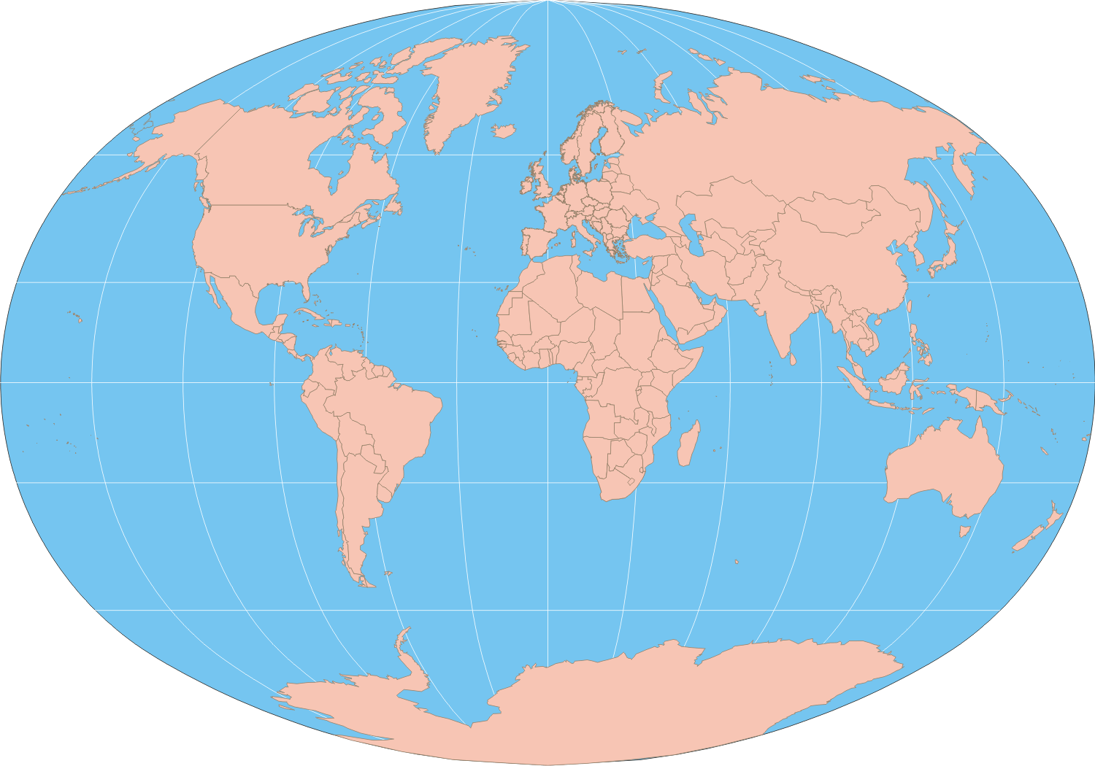

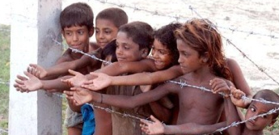
Refuge International Fellowship
Reaching the Unreached World
R F

Slide 2

Understanding “Refuge”
Introduction
Jesus Himself was a refugee in Egypt as a child. (Matt 2:13).
Also, Adam & Eve were refugees from the Garden of Eden. (Gen 3:10)
Everyone, from Kings & Presidents to the common man, are actually refugees; our citizenship is in heaven – before coming to Christ, we were all refugees spiritually.
God is our REFUGE. (Psalm 46:1)
RIF is an international, evangelistic Church
planting movement.
R: Reliable
E: Eternal
F: Fellowship
U: Unknown
G: God
E: Ever

Slide 3

MINISTRY VISION
Matt. 28:19-20
Reaching the unreached nations and
saving unsaved souls has always been
Christ’s vision for the lost world.
Therefore, RIF is committed to fulfill
this vision through aggressive
evangelism and church planting.
Winning the United States today and the world tomorrow is our vision.

Slide 4

Mission Statement
Act 1:8
For the son of man came to seek and to save what was lost. (Luke 19:10)
For Christ Himself is the true missionary.
Moreover, Refuge International Fellowship
is actively pursuing Christ’s mission
through discipleship ministries:
winning, building ,training and sending are all aspects of a fruitful discipleship ministry.

Slide 5
Goal
1 Thess 3:6-10
Church Planting is a God-given, on-going ministry.
In each calendar year, we desire to harvest the following over-ripe fruits:
# | Ministries | Accomplishment | Remarks
1 | Evangelism | 10,000
2 | Win | 500
3 | Build | 300
4 | Train | 100
5 | Send to win | 100

Slide 6
Strategies
Vivid vision meaningful mission along with gigantic goal could not come true unless there are several strategies.
John 4
Music
Film/TV
Charities
Medical
Orphanage & Widow
Internet
Sport
Radio
Literature
Education
Prison
Prayer Everywhere
Youth Ministry
Personal Evangelism

Slide 7
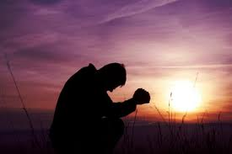
RIF Report
The vision for church planting ministry
has been developing over 15 years.
Its implementation began in
December 2010 in the city of Buffalo, NY.
As a result, there are already seventeen churches established in USA, Bhutan,
Nepal, and India.

Slide 8
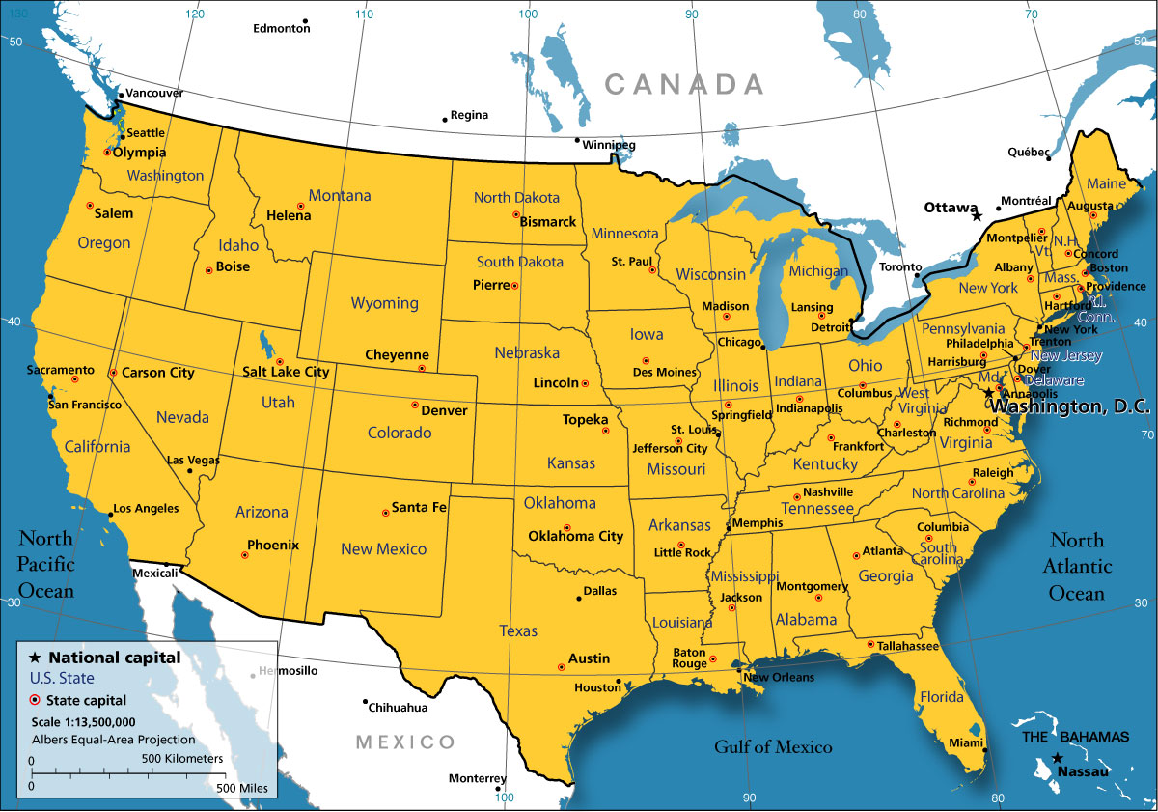

Slide 9
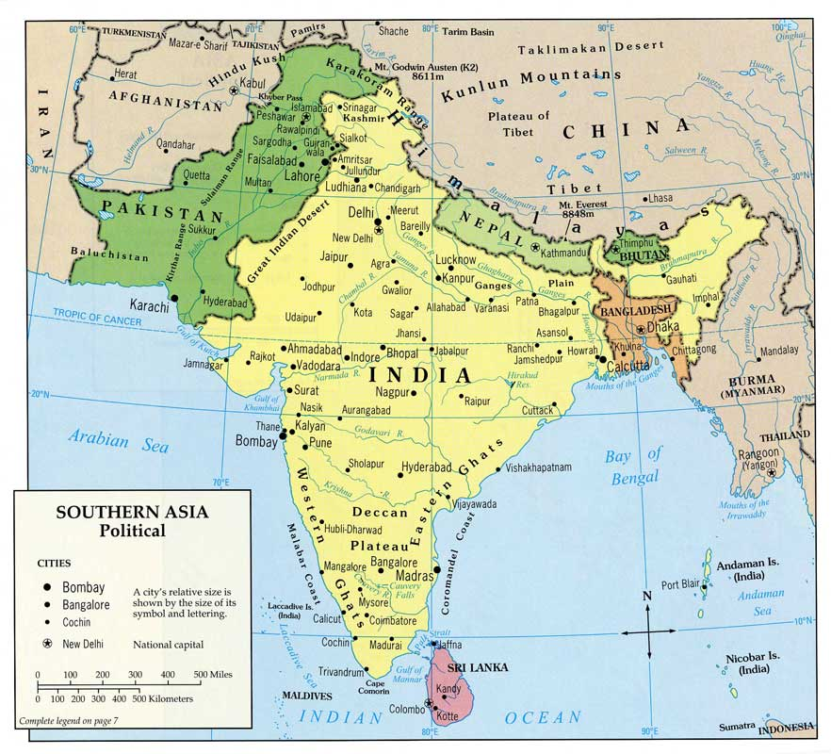

Slide 10
RIF Report
In addition, the following ministries have
also been started under the church planting movement:
Prayer Everywhere
Youth for Mission
Women’s Ministry
Discipleship Bible School
Facebook Ministry
Orphanage
Funeral Fund
Here are some of the ministries picture reports with Documented Video.

Slide 11

Needs of Ministries
1 cor 16:1-4
Wisdom for ministry (James 1:5)
Twenty fulltime staff
Staff financial support
Ministries financial support (Bible School)
Ministry follow-up travel expenses
Office
Church Buildings in US and in South Asia
Volunteers

Slide 12

Prayer Points
Please pray for accomplishment of Church planting vision and goal.
Pray that the Lord will grant wisdom in carrying out the ministry.
Please pray for ministries’, orphanage staff’s and church planters’ monthly financial supports.
Please pray for resources needed to provide leadership training in Asia to support the ministry in India, Nepal, and Bhutan.

Slide 13

Appreciation
Thank you so much for being a part of this Evangelistic Outreach and Church Planting Movement.
Your prayers and financial support have been greatly appreciated.

